Slide 1
Genetic recombination:
1.Homologous Recombination
2. Site-Specific Recombination
3. DNA Transposition

Slide 2
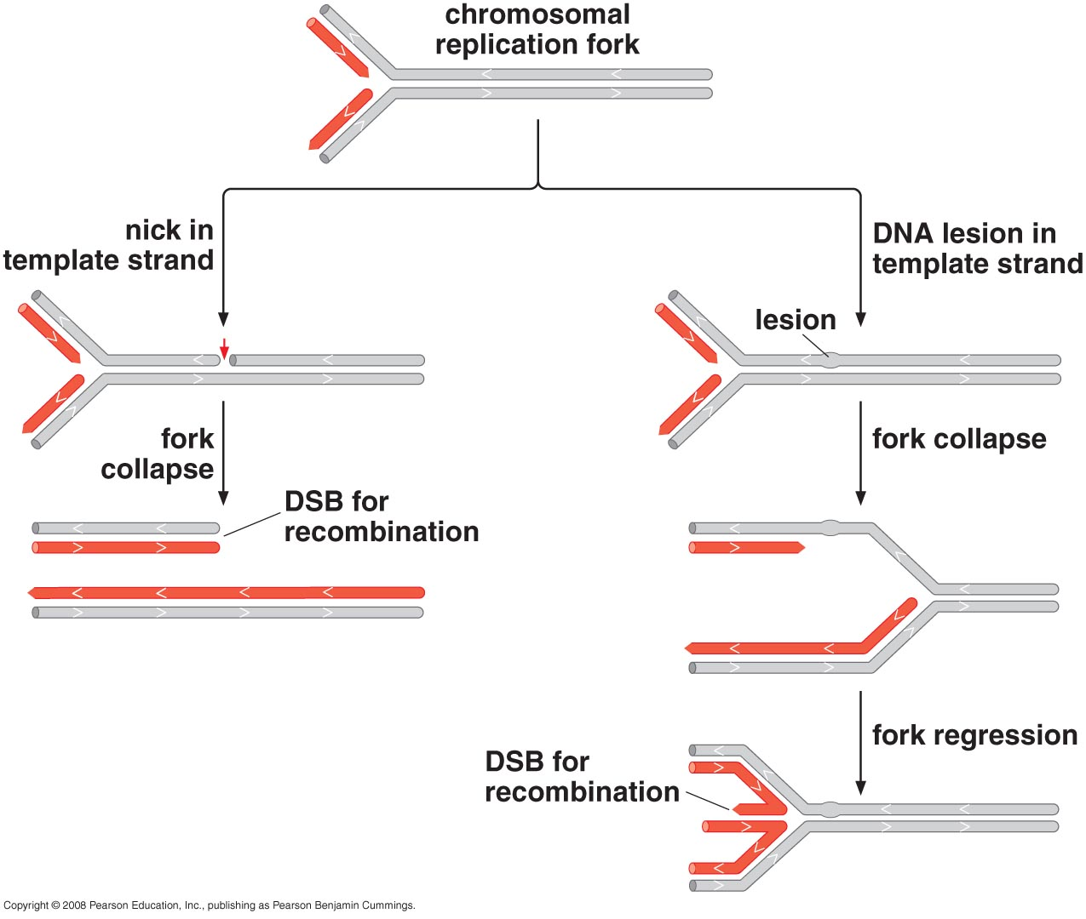
Homologous Recombination at the Molecular Level
DNA BREAKS ARE COMMON AND INITIATE RECOMBINATION

Slide 3
Recombination repair DNA breaks by retrieving sequence information from undamaged DNA
Double-Strand Breaks are Efficiently Repaired

Slide 4
MODELS FOR HOMOLOGOUS RECOMBINATION
Notes:
Strand exchange & Branch migration are the two key steps

Slide 5
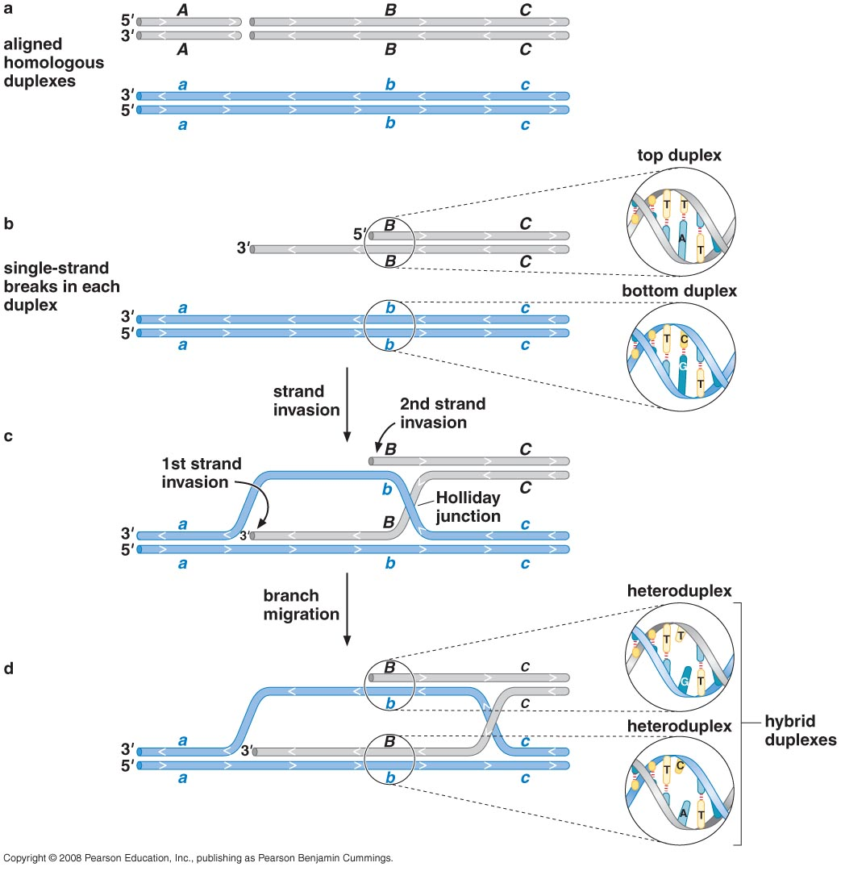
Strand invasion (strand exchange) is a key step in homologous recombination

Slide 6
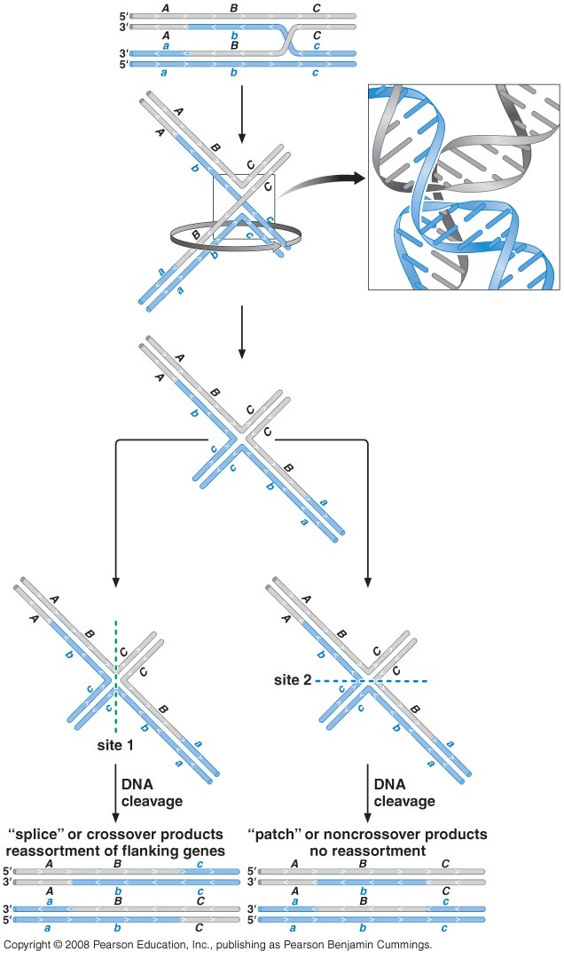
Resolving Holliday junctions is a key step (final step) to finishing genetic exchange

Slide 7
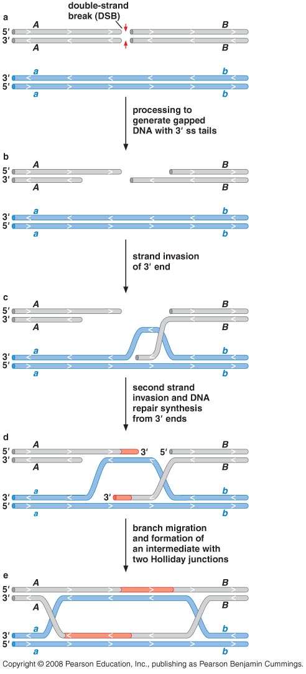
The double-strand break-repair model describes many recombination events

Slide 8
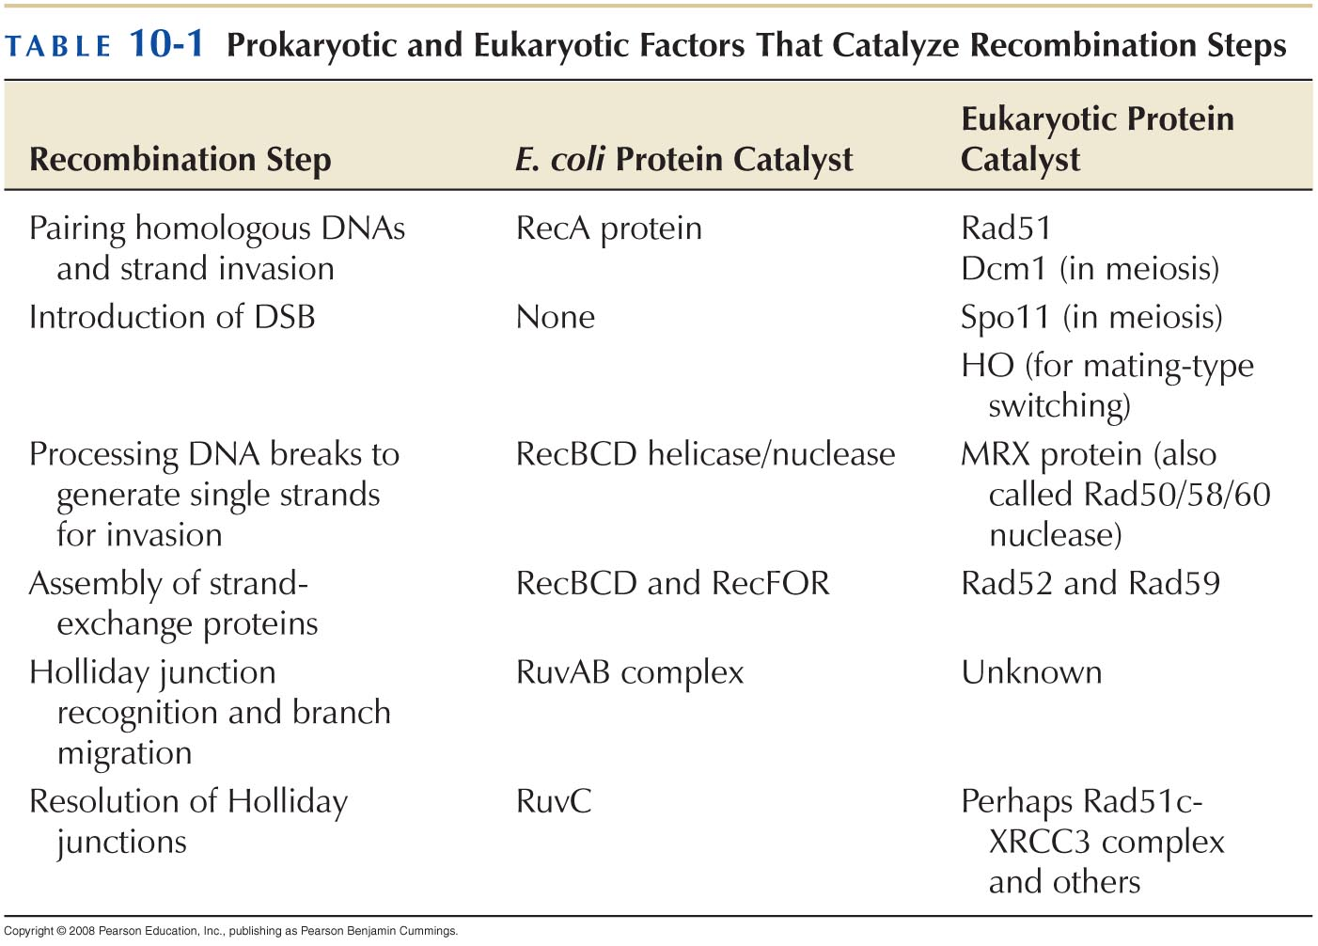
HOMOLOGOUS RECOMBINATION PROTEIN MACHINES

Slide 9
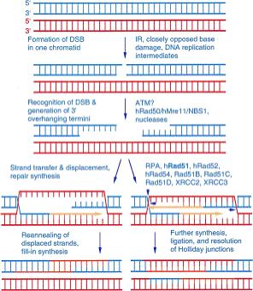
RecBCD
RecA
RuvAB
RuvC

Slide 10
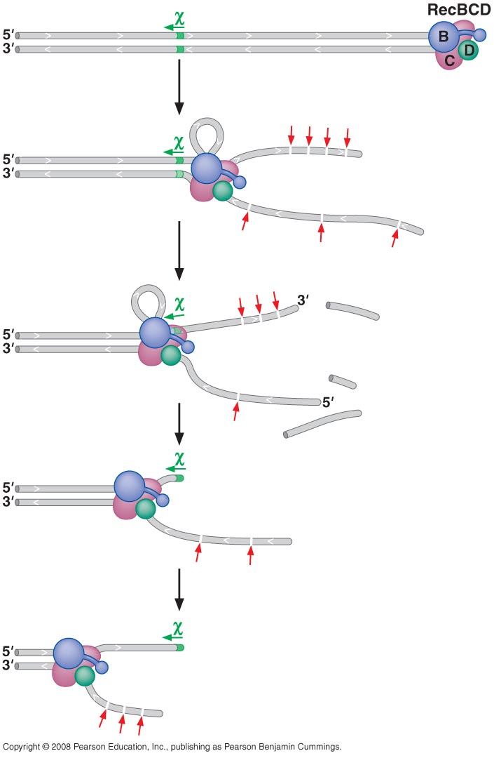
The RecBCD helicase/nuclease processes broken DNA molecules for recombination
χ-site 5'-GCTGGTGG-3'.

Slide 11
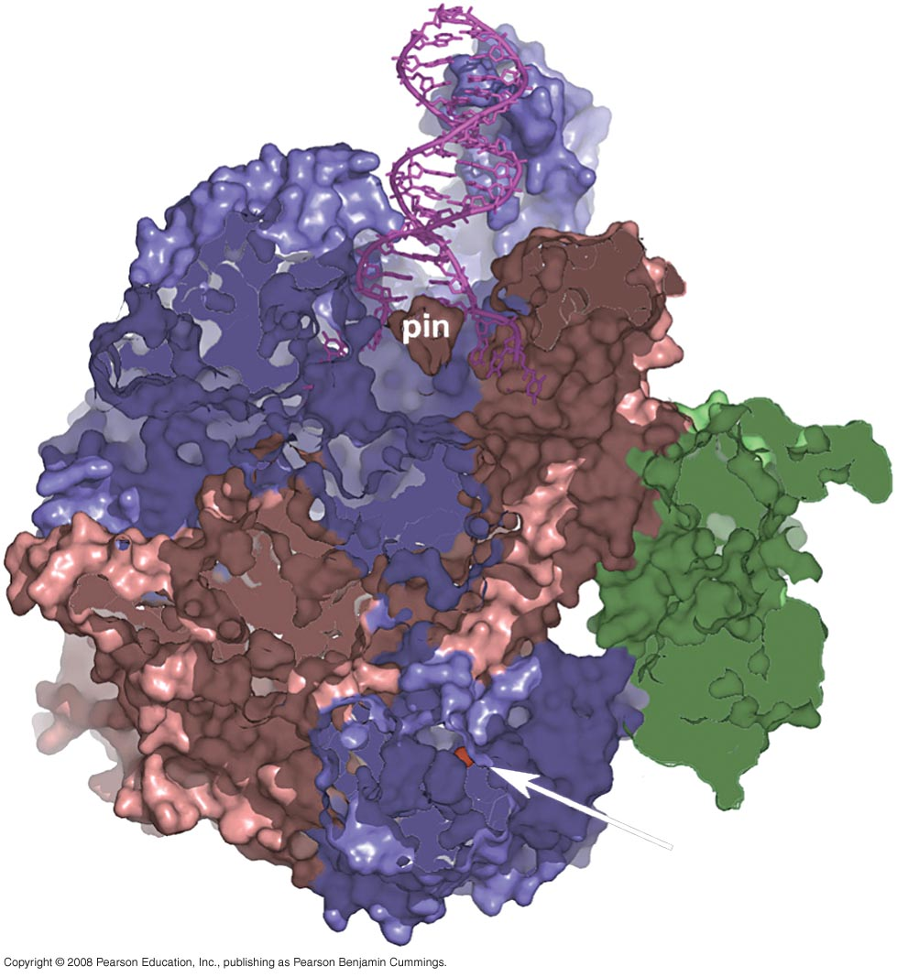
Structure of RecBCD

Slide 12
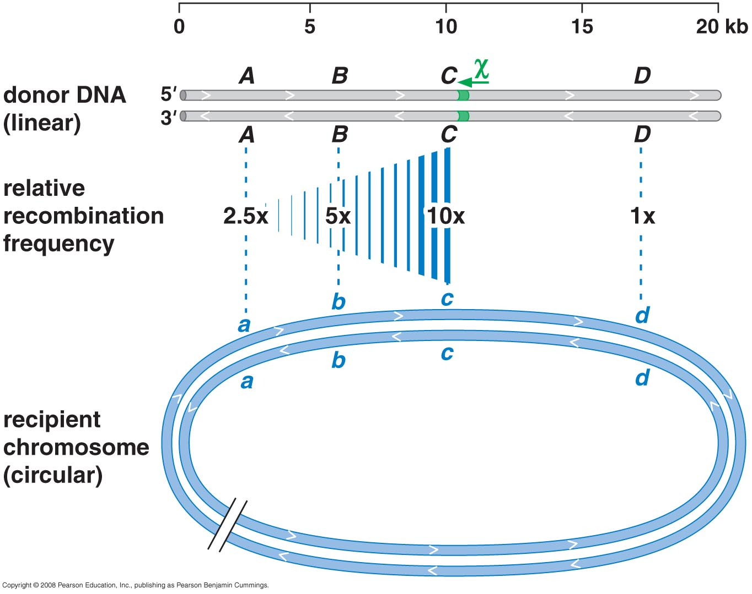
Chi sites control RecBCD (GCTGGTGG)

Slide 13
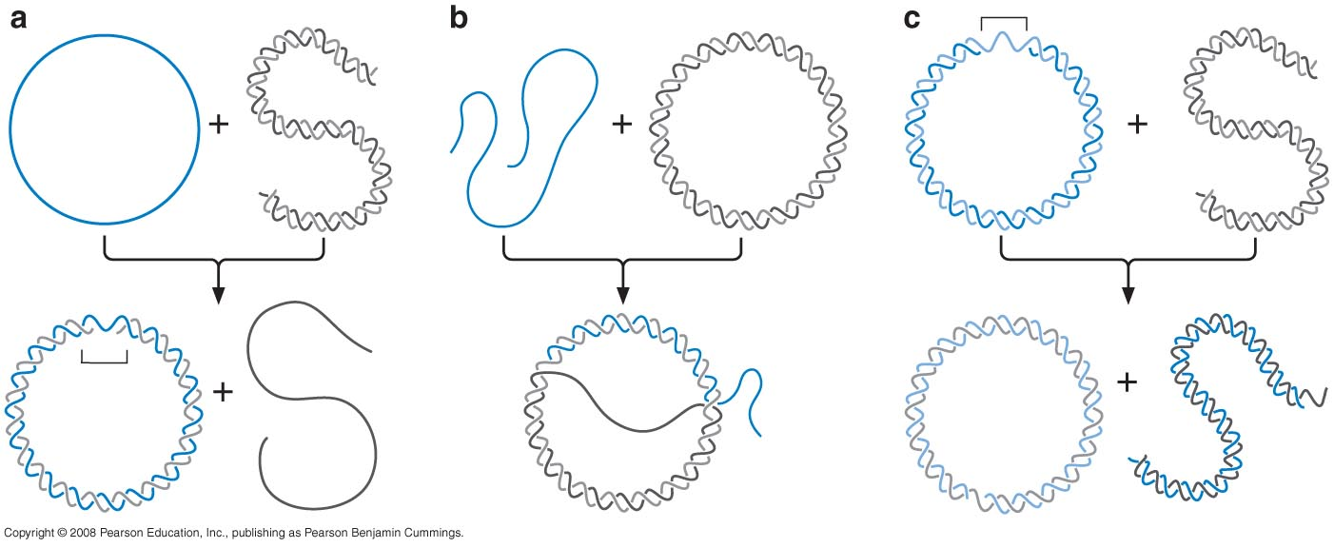
RecA protein assembles on single-stranded DNA and promotes strand invasion

Slide 14
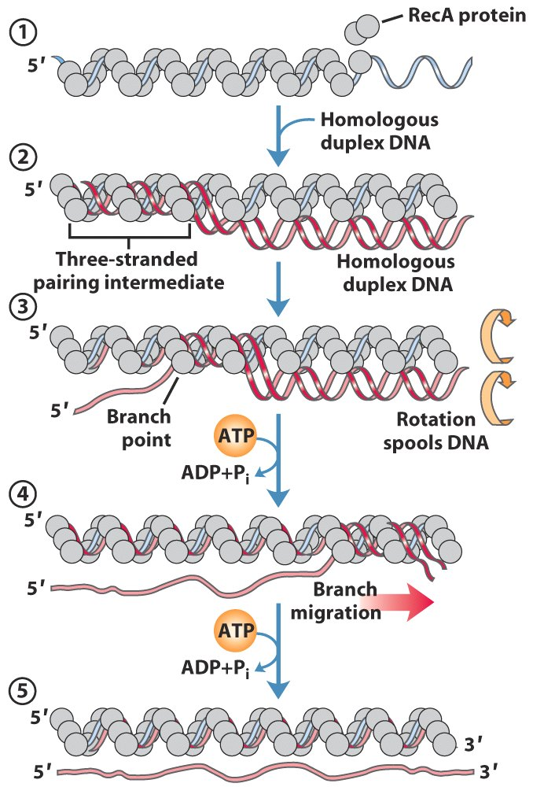
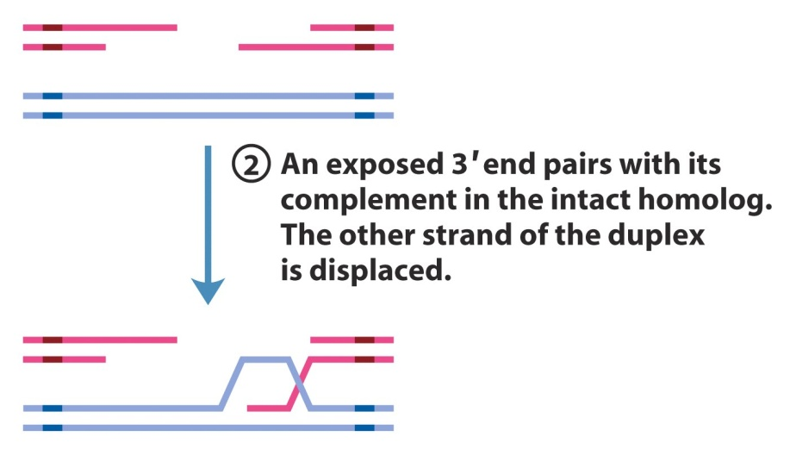

Slide 15
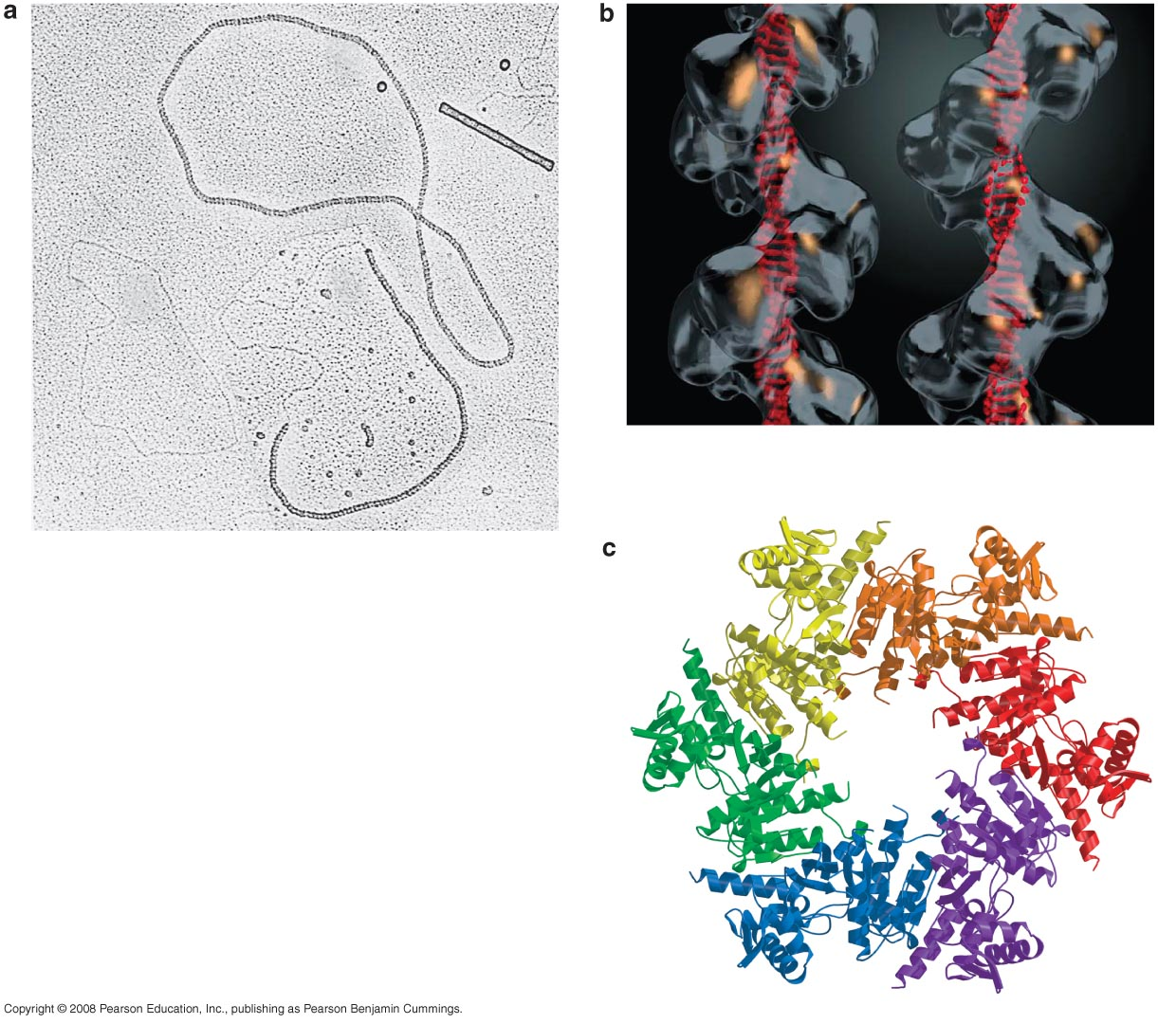
Three views of the RecA filament

Slide 16
Polarity of RecA assembly

Slide 17
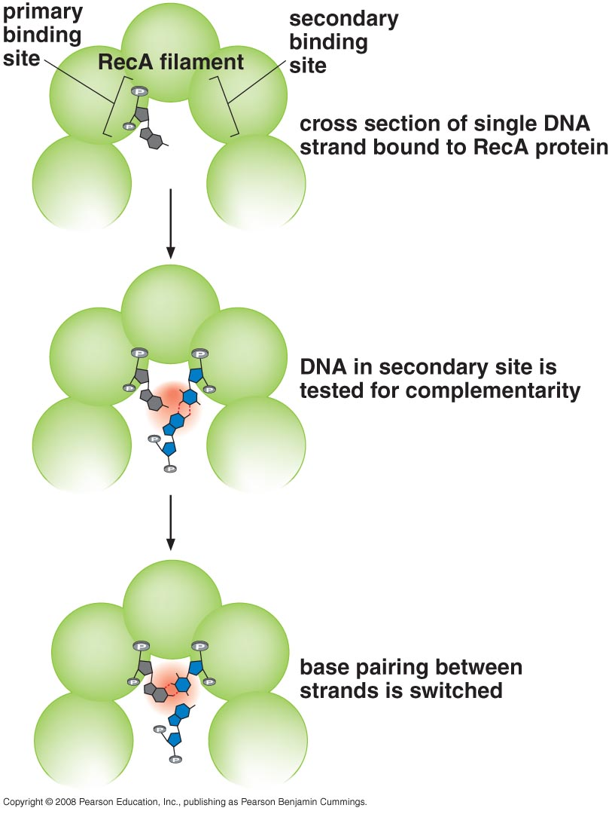
Newly based-paired partners are established within RecA filament

Slide 18
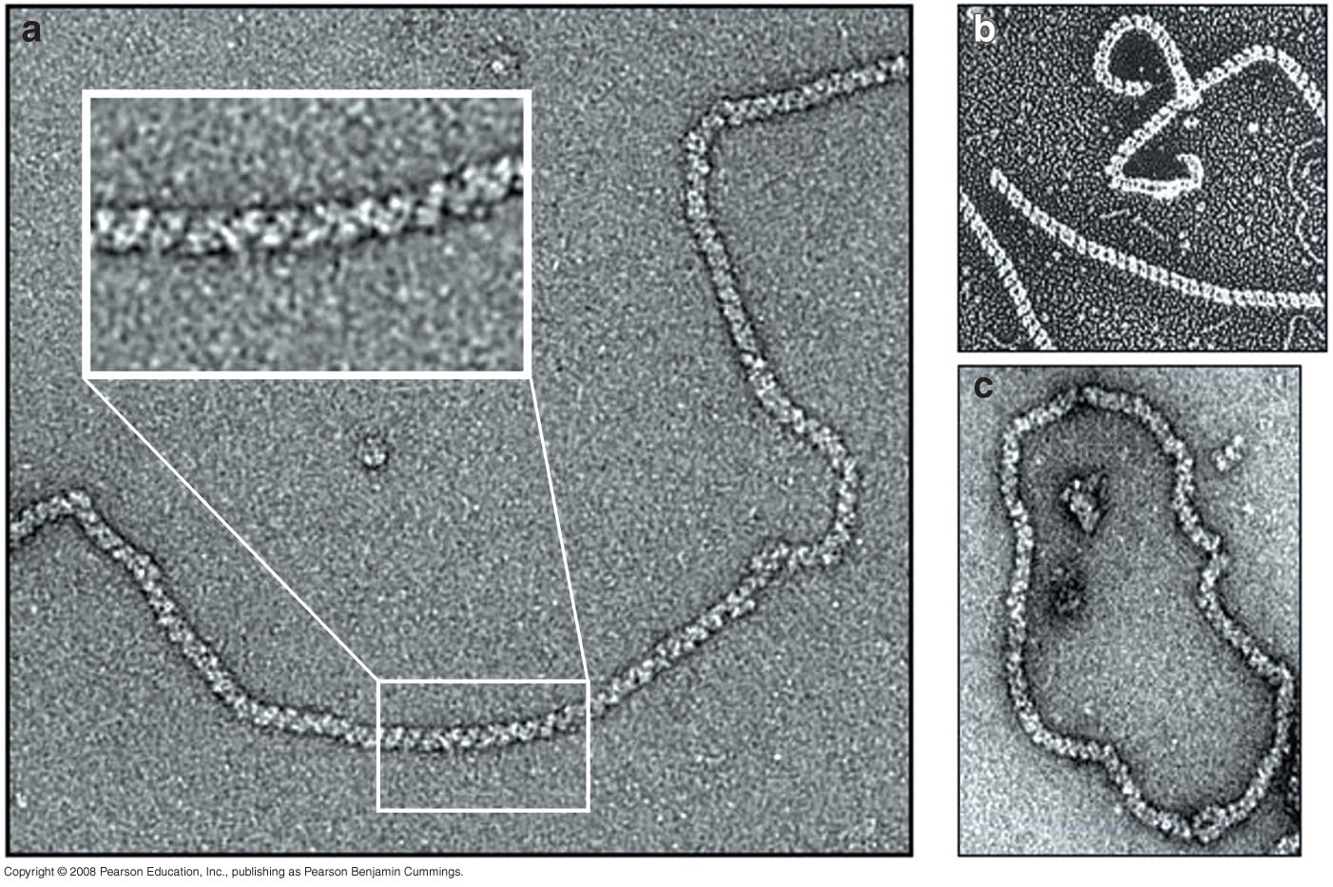
RecA homologs are present in all organism
Human Rad51
RecA
Rad A of Archaea

Slide 19
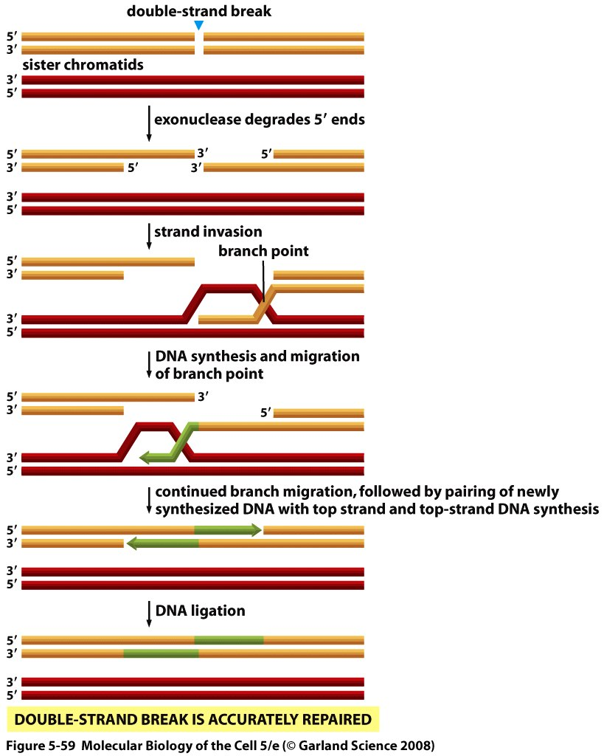
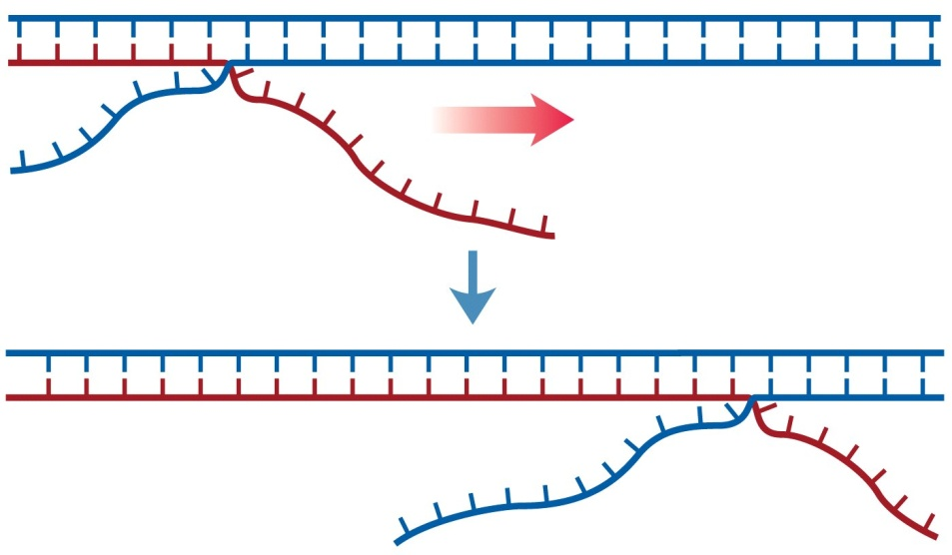
The RuvAB complex specifically recognizes Holliday junctions and promote branch migration

Slide 20
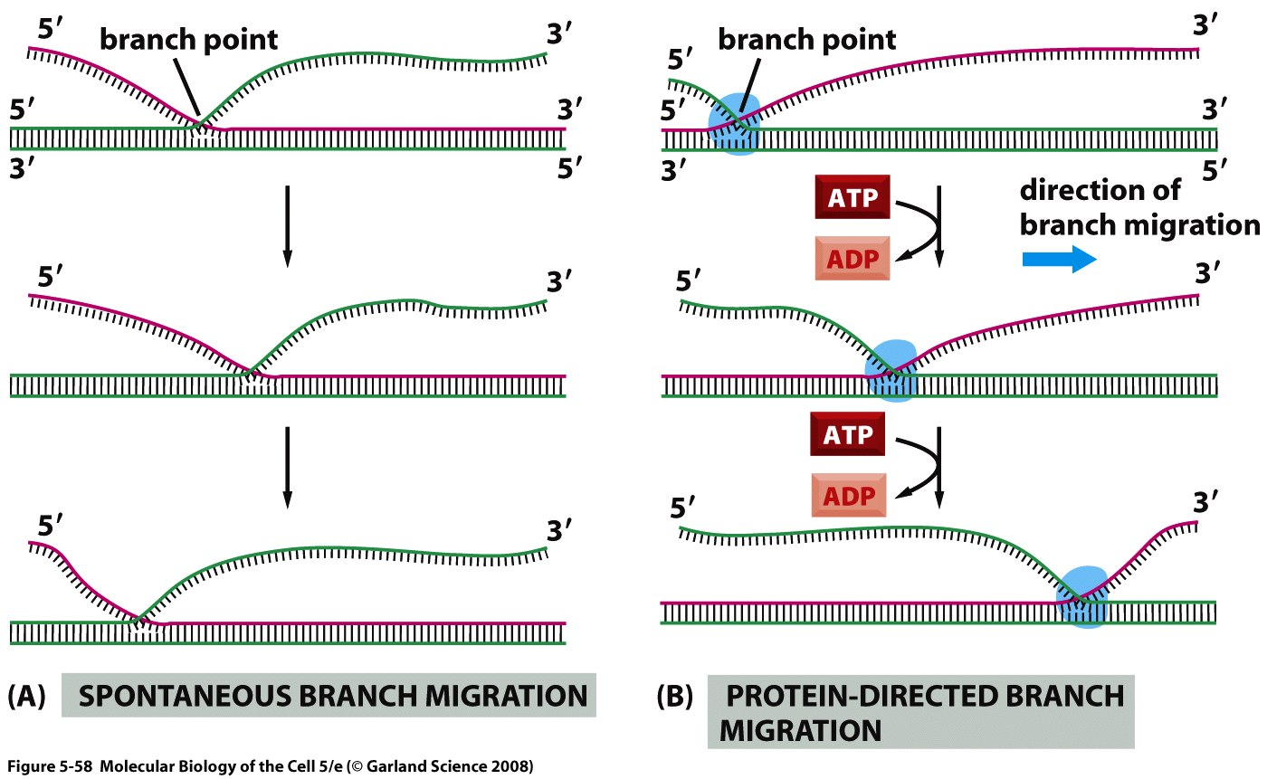
Branch migration can either enlarge heteroduplex regions or release newly synthesized DNA as a single strand

Slide 21
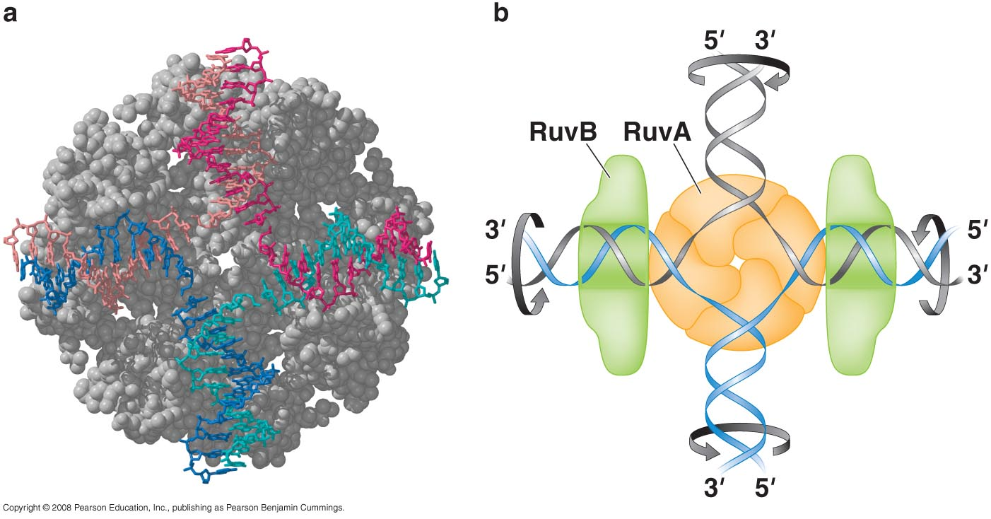
Structure of RuvA and model of RuvAB bound to Holliday junction

Slide 22
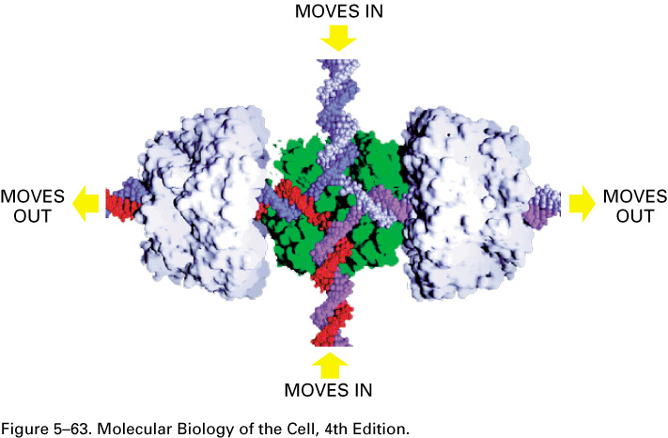
Enzyme-catalyzed double branch migration at a Holliday junction.
In E. coli, a tetramer of the RuvA protein (green) and two hexamers of the RuvB protein (pale gray) bind to the open form of the junction. The RuvB protein uses the energy of ATP hydrolysis to move the crossover point rapidly along the paired DNA helices, extending the heteroduplex region as shown. There is evidence that similar proteins perform this function in vertebrate cells. (Image courtesy of P. Artymiuk; modified from S.C. West, Cell 94:699–701, 1998.)

Slide 23
RuvC cleaves specific strands at the Holliday junction to finish recombination

Slide 24
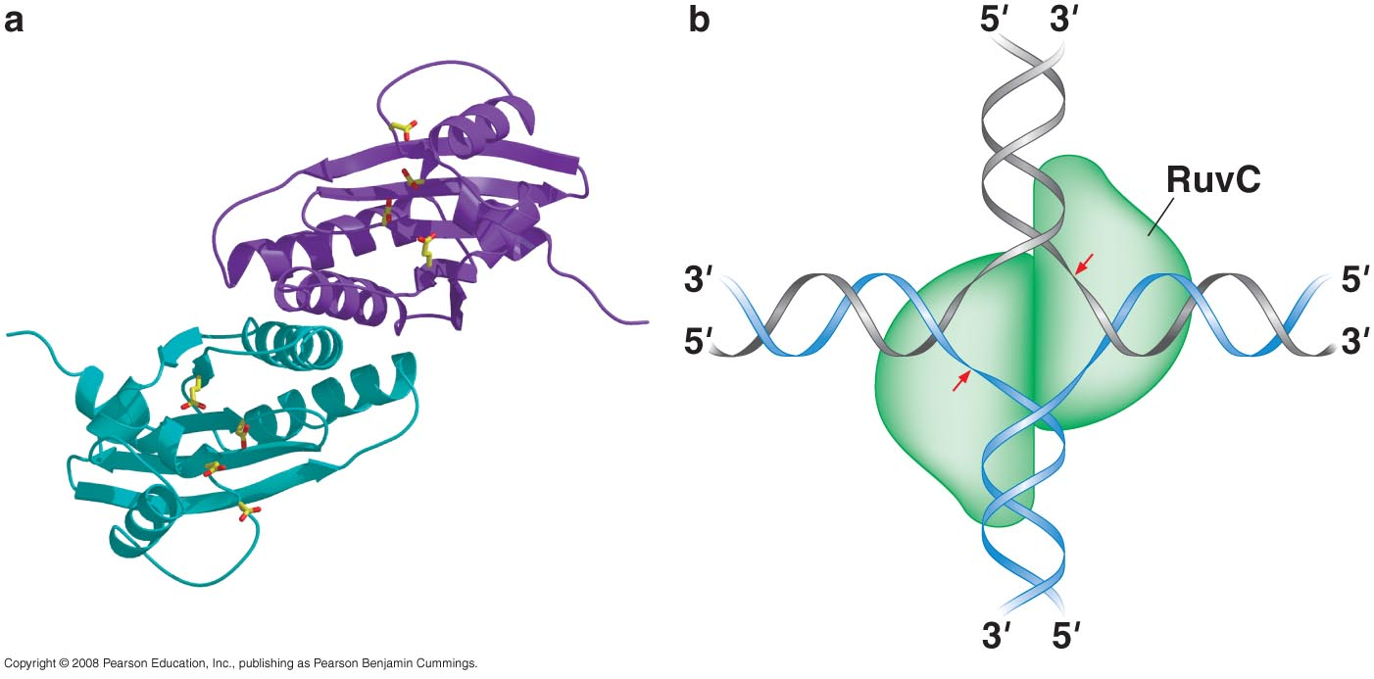
Structure of RuvC and model of RuvC dimer bound to Holliday junction

Slide 25
RecBCD
RecA
RuvAB
RuvC

Slide 26
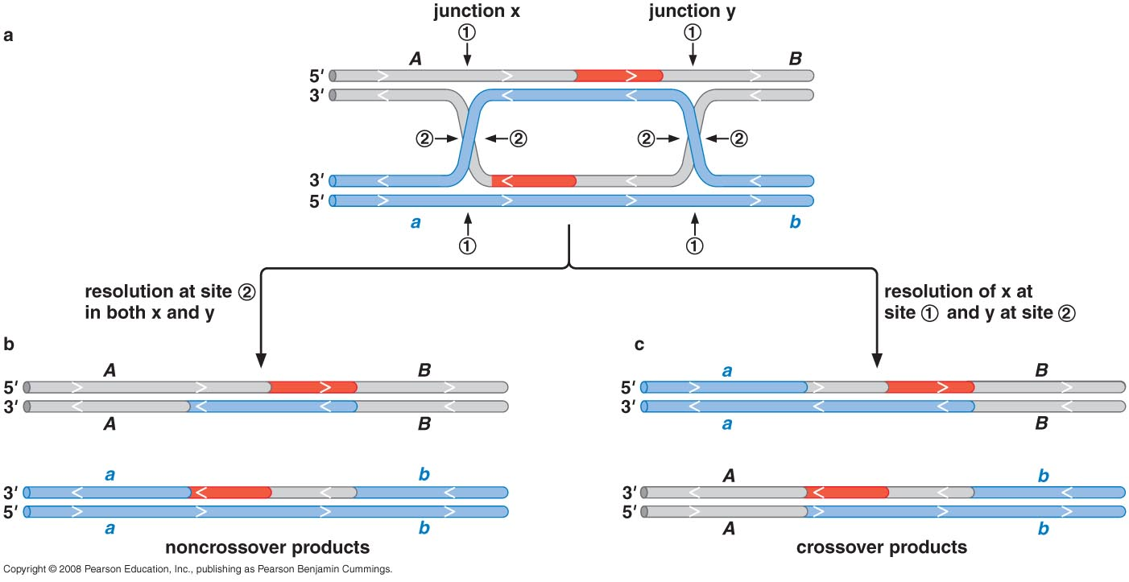
How to resolve a recombination intermediate with two Holliday junctions

Slide 27
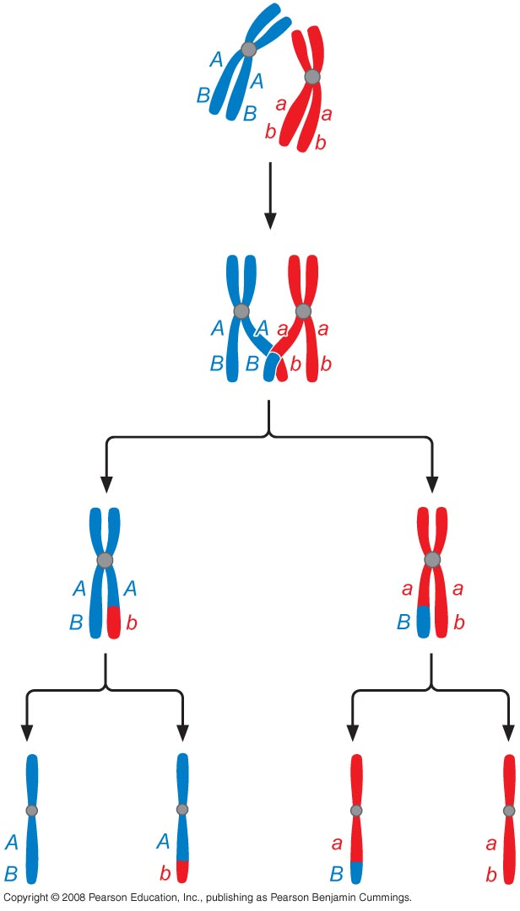
HOMOLOGOUS RECOMBINATION IN EUKARYOTES
Homologous recombination has additional functions in eukaryotes
It is required to pair homologous chromosomes in preparation for the first nuclear division and for segregation during meiosis

Slide 28
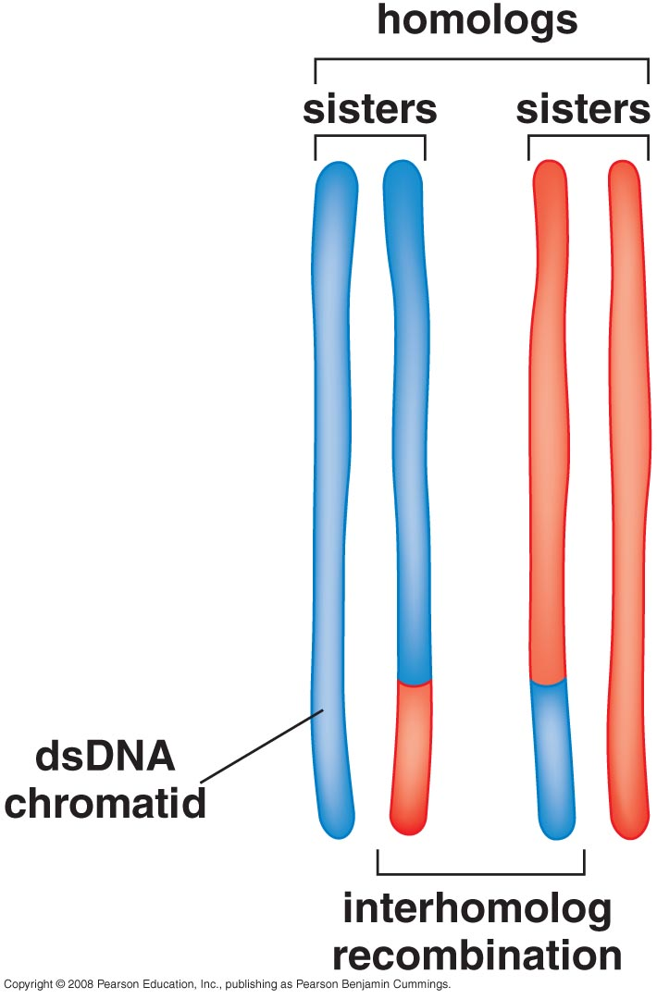
Meiotic recombination between homologous chromatids

Slide 29
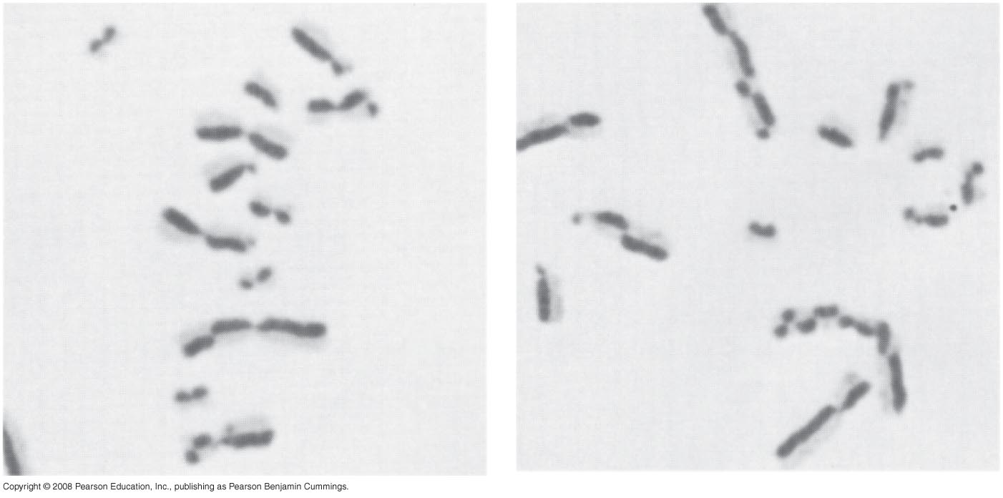
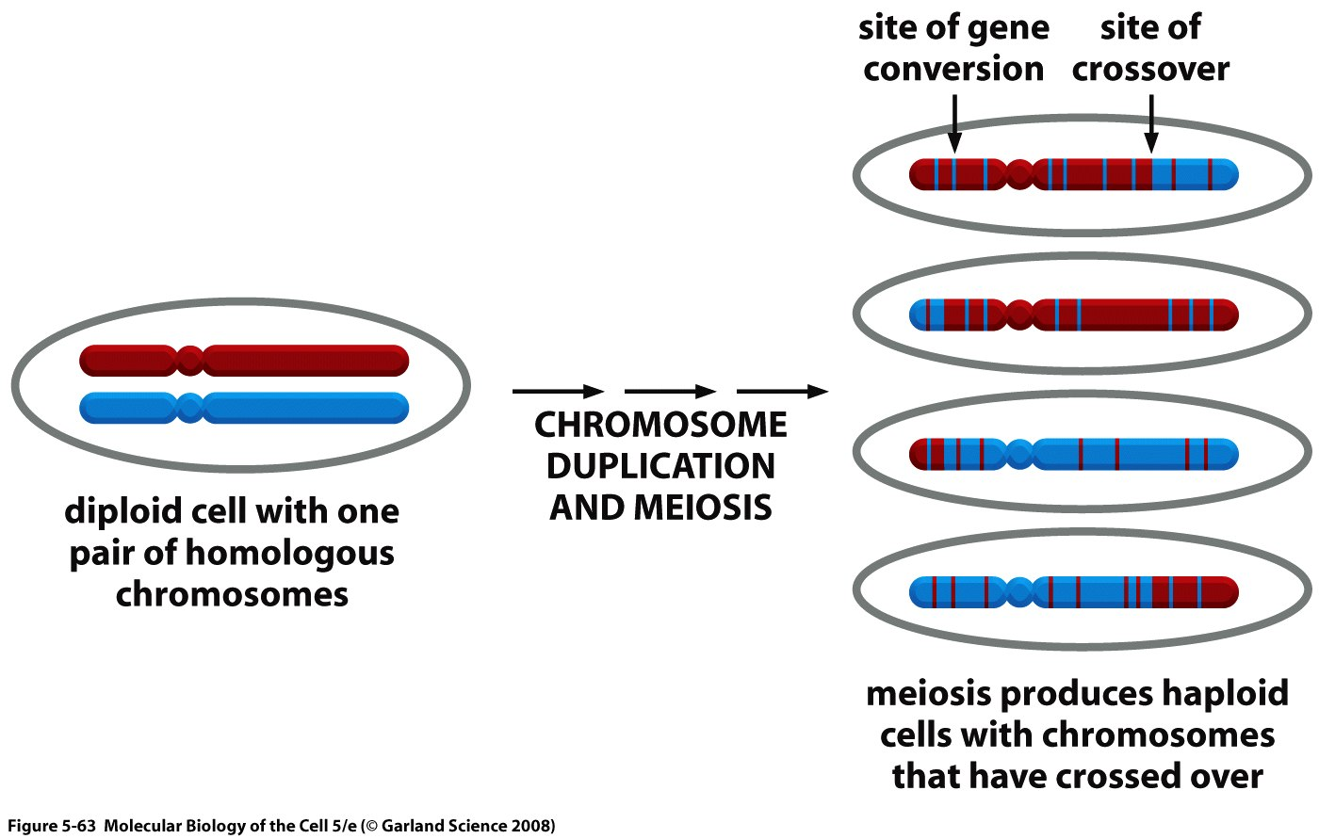
Meiotic recombination also frequently gives rise to crossing over between genes on the two homologous parental chromosomes

Slide 30
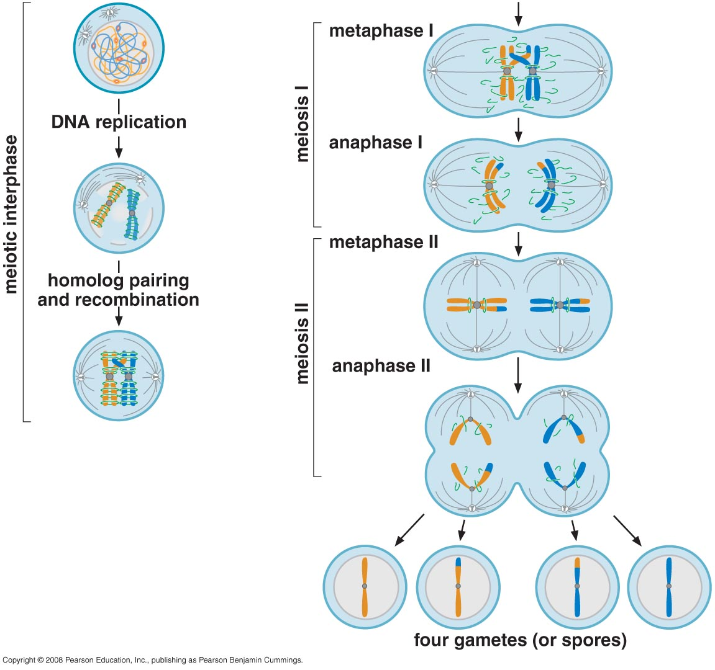

Slide 31
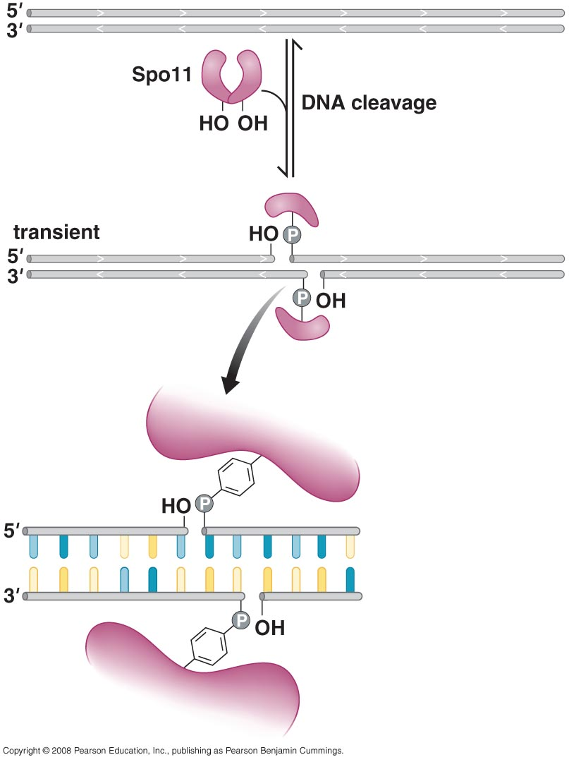
Programmed generation of double-stranded DNA breaks occurs during meiosis

Slide 32
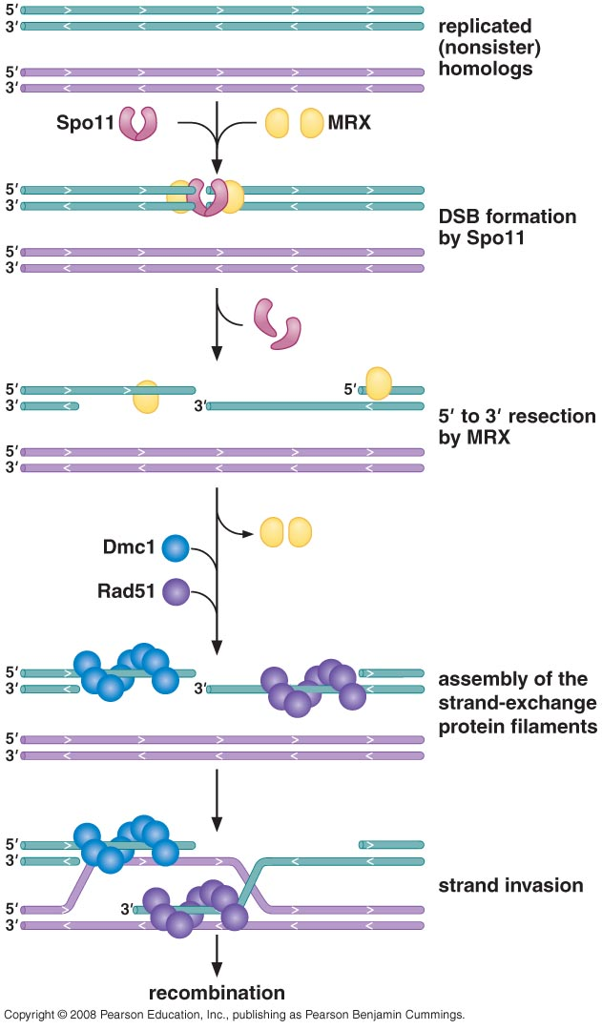
MRX protein processes the cleaved DNA ends for assembly of the RecA-like strand exchange proteins (DMC1, Rad51)
DMC1 specifically functions in meiotic recombination

Slide 33
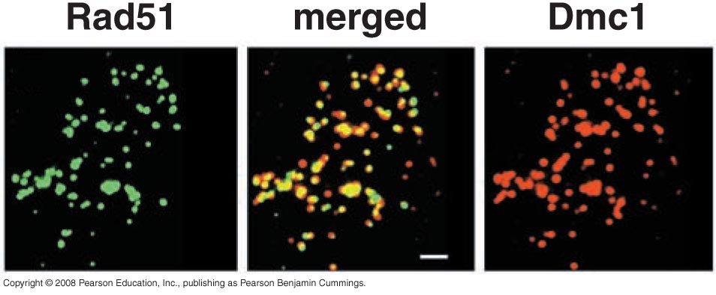
Many proteins function together to promote meiotic recombination (Rad51, DMC1, Rad51 paralogs, Rad52, Rad54)

Slide 34
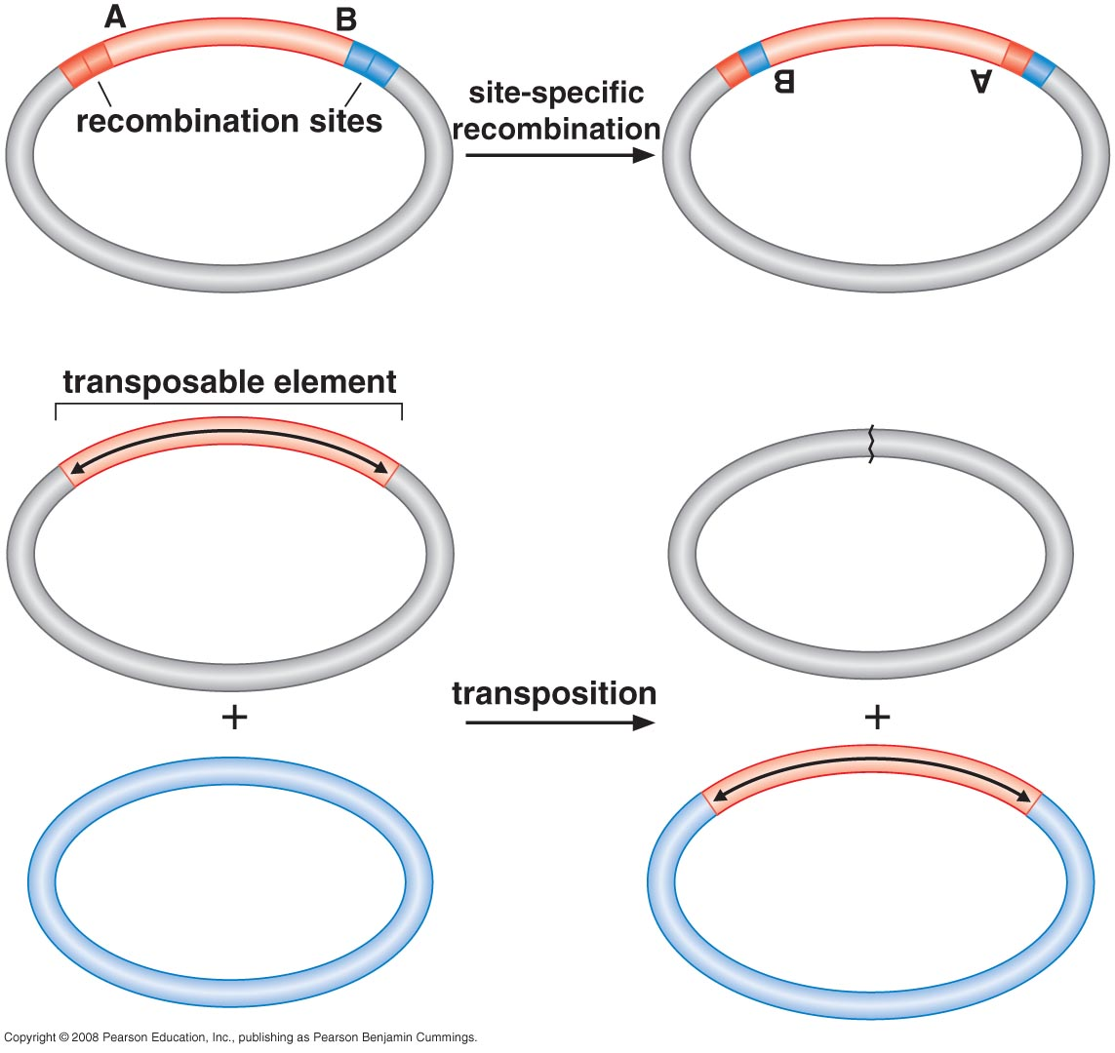
Site-Specific recombination & Transposition

Slide 35
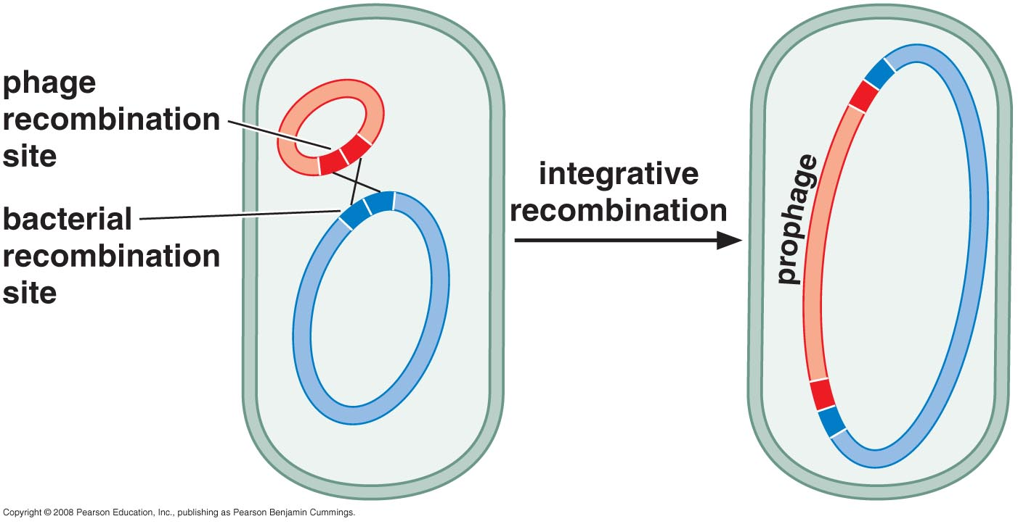
Conservative site-specific recombination

Slide 36
Three types of CSSR

Slide 37
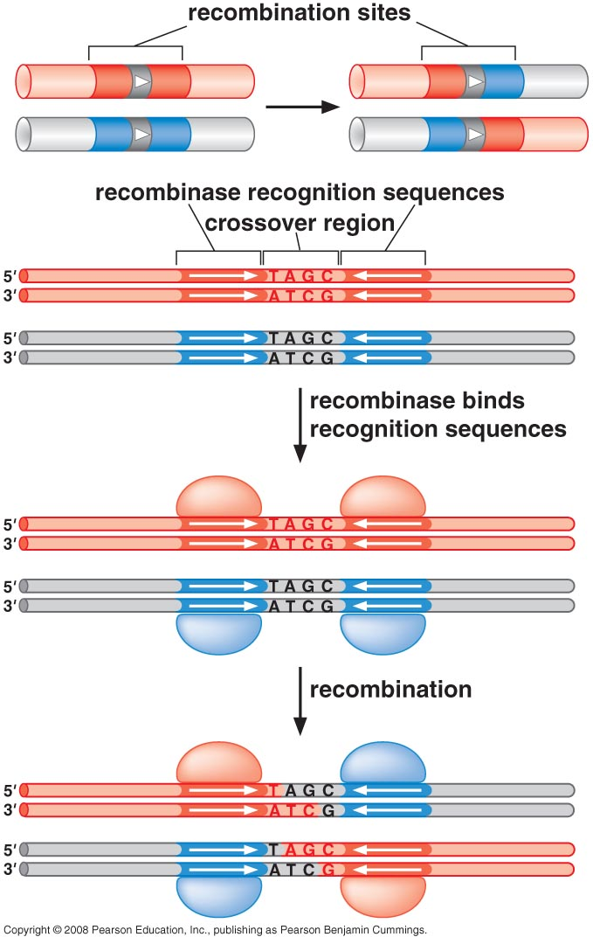
Structures involved in CSSR

Slide 38
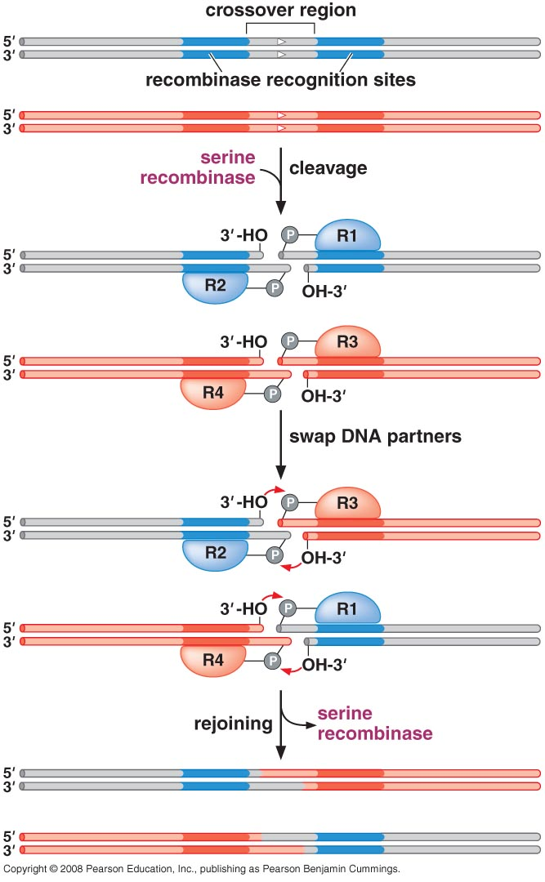
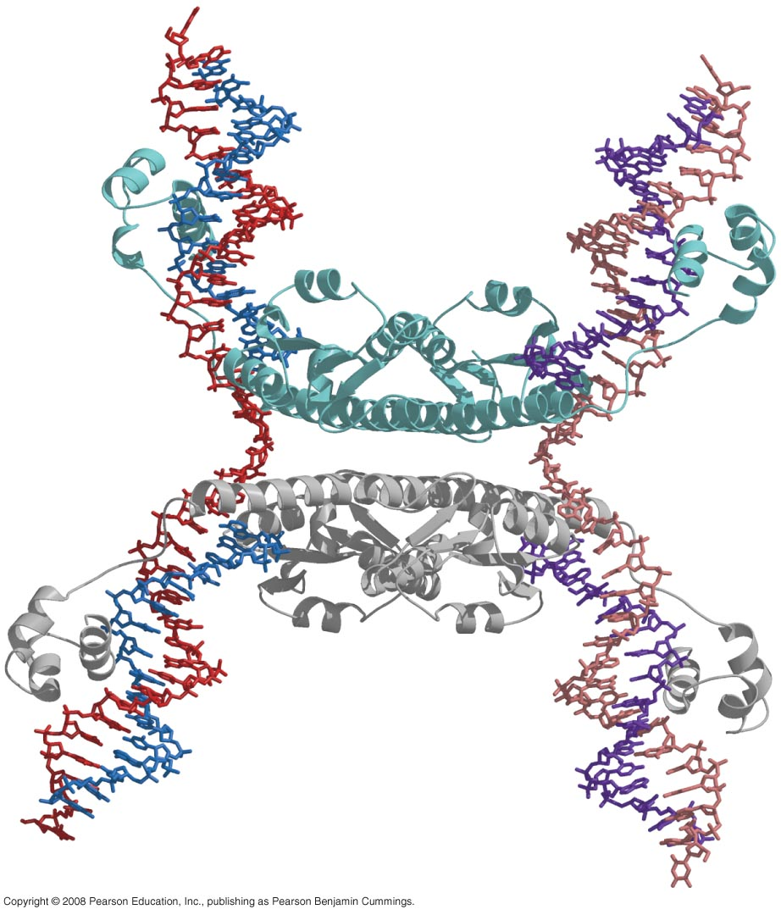
Recombination by a serine recombinase

Slide 39
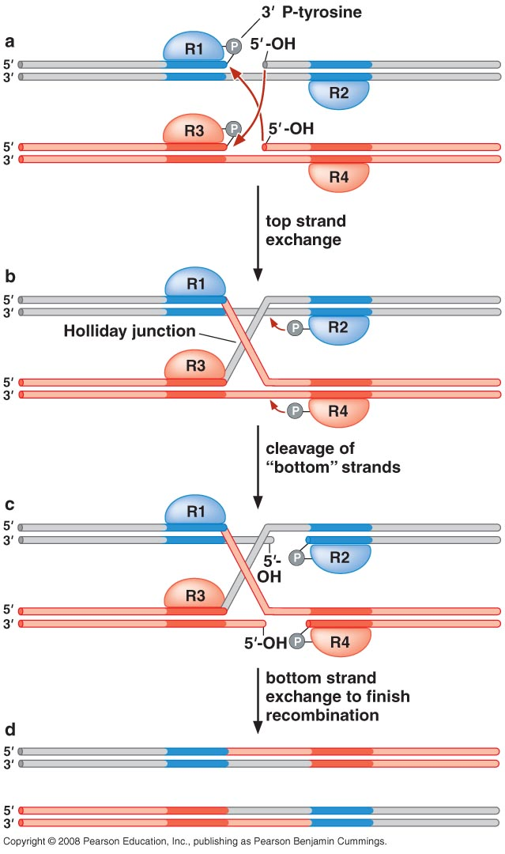
Recombination by a tyrosine recombinase

Slide 40
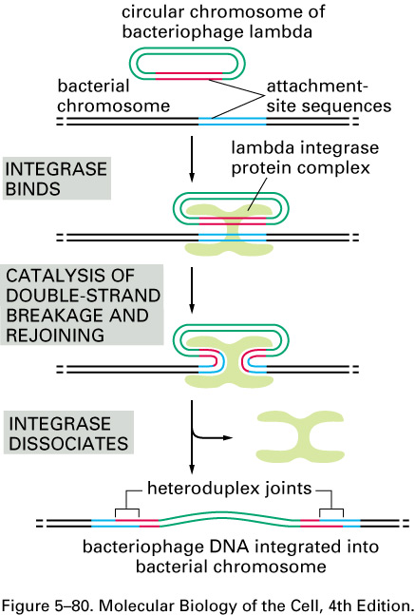
Conservative site-specific recombination was discovered in bacteriophage lambda
The insertion of a circular bacteriophage lambda DNA chromosome into the bacterial chromosome.

Slide 41
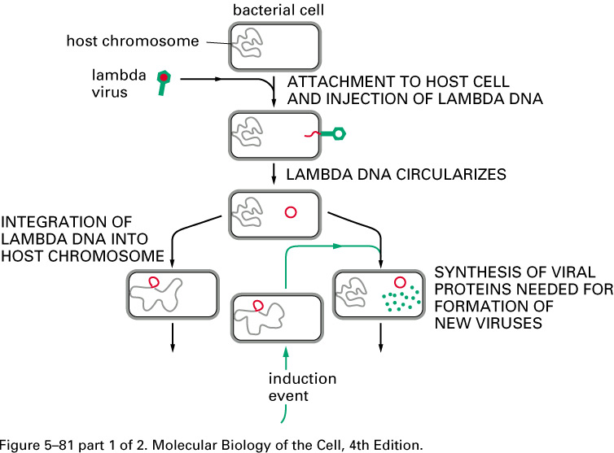
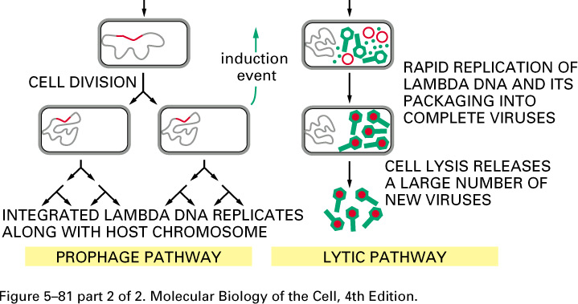
The life cycle of bacteriophage lambda.
The double-stranded DNA lambda genome contains 50,000 nucleotide pairs and encodes 50–60 different proteins. When the lambda DNA enters the cell, the ends join to form a circular DNA molecule. This bacteriophage can multiply in E. coli by a lytic pathway, which destroys the cell, or it can enter a latent prophage state. Damage to a cell carrying a lambda prophage induces the prophage to exit from the host chromosome and shift to lytic growth (green arrows). Both the entrance of the lambda DNA to, and its exit from, the bacterial chromosome are accomplished by a conservative site-specific recombination event, catalyzed by the lambda integrase enzyme (see Figure 5–80).

Slide 42
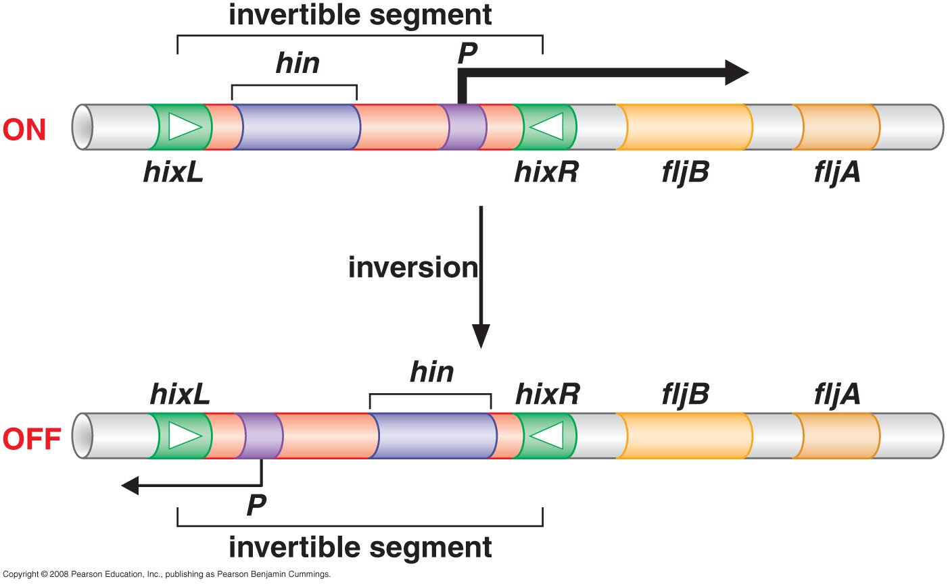
DNA inversion by the Hin recombinase of Salmonella

Slide 43
Transposition
Some genetic elements move to new chromosomal locations by transposition

Slide 44
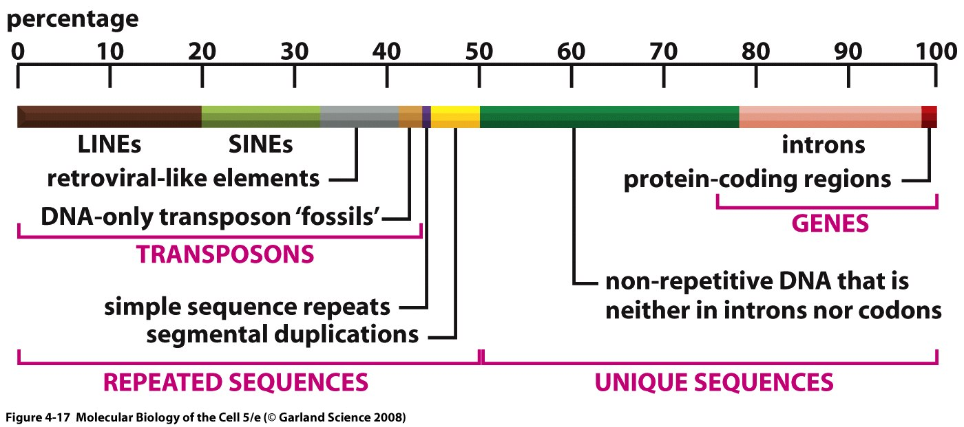
Genes make up only a small portion of the eukaryotic chromosomal DNA
Representation of the nucleotide sequence content of the human genome.
LINES, SINES, retroviral-like elements, and DNA-only transposons are all mobile genetic elements that have multiplied in our genome by replicating themselves and inserting the new copies in different positions. Simple sequence repeats are short nucleotide sequences (less than 14 nucleotide pairs) that are repeated again and again for long stretches. Segmental duplications are large blocks of the genome (1000–200,000 nucleotide pairs) that are present at two or more locations in the genome. Over half of the unique sequence consists of genes and the remainder is probably regulatory DNA. Most of the DNA present in heterochromatin, a specialized type of chromatin that contains relatively few genes, has not yet been sequenced
Notes:
What does this means is, show on the blackboard

Slide 45
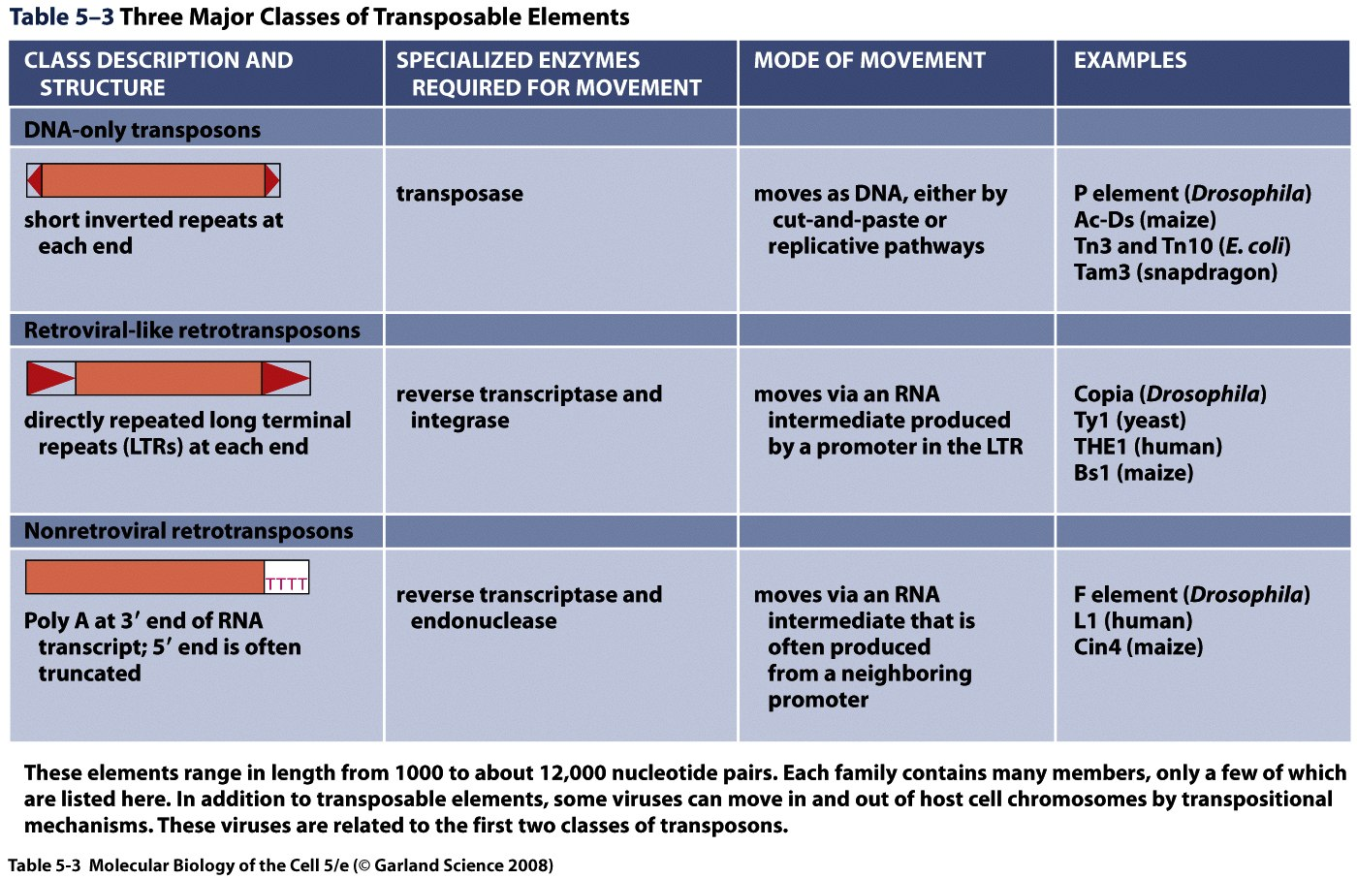

Slide 46
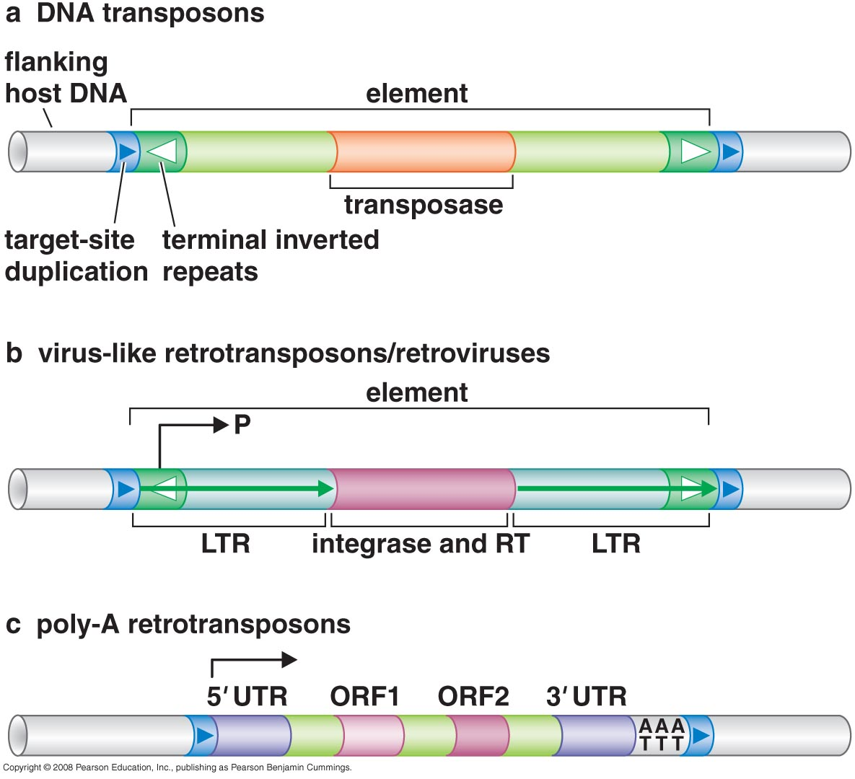

Slide 47
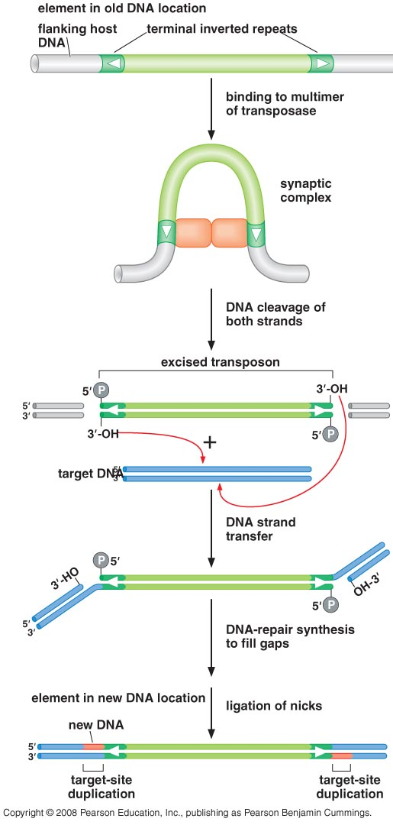
The cut-and-paste mechanism of transposition
(DNA transposons)

Slide 48
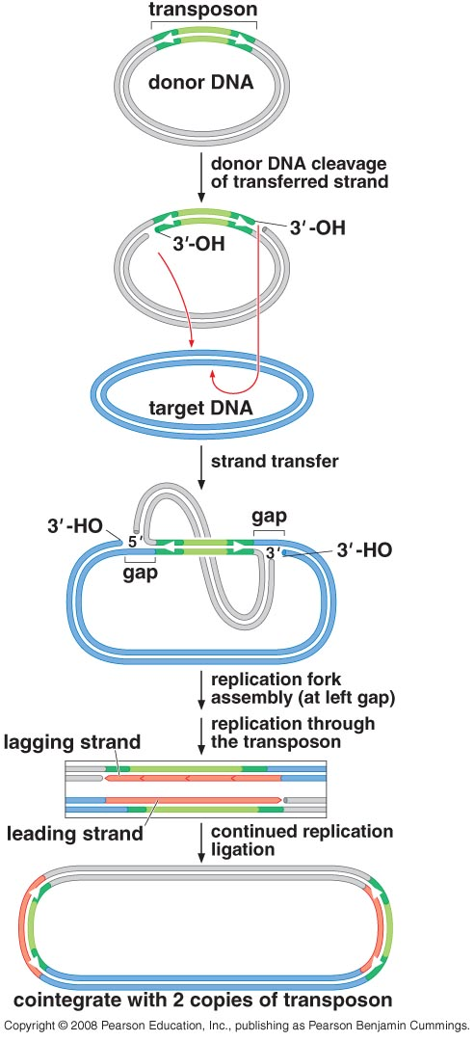
Replicative transposition
(DNA transposons)

Slide 49
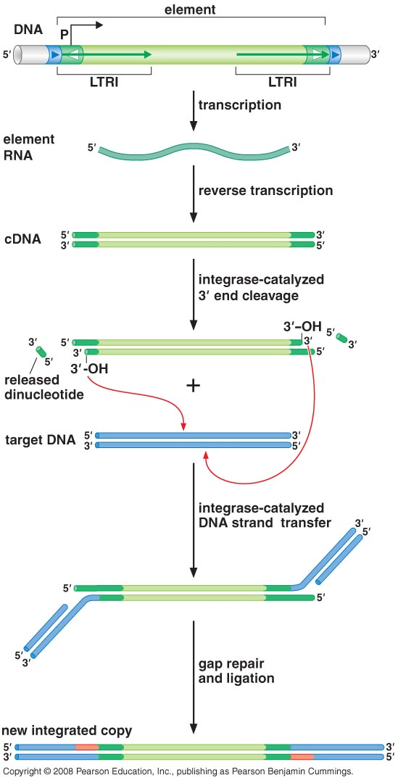
Virus-like retrotransposons

Slide 50
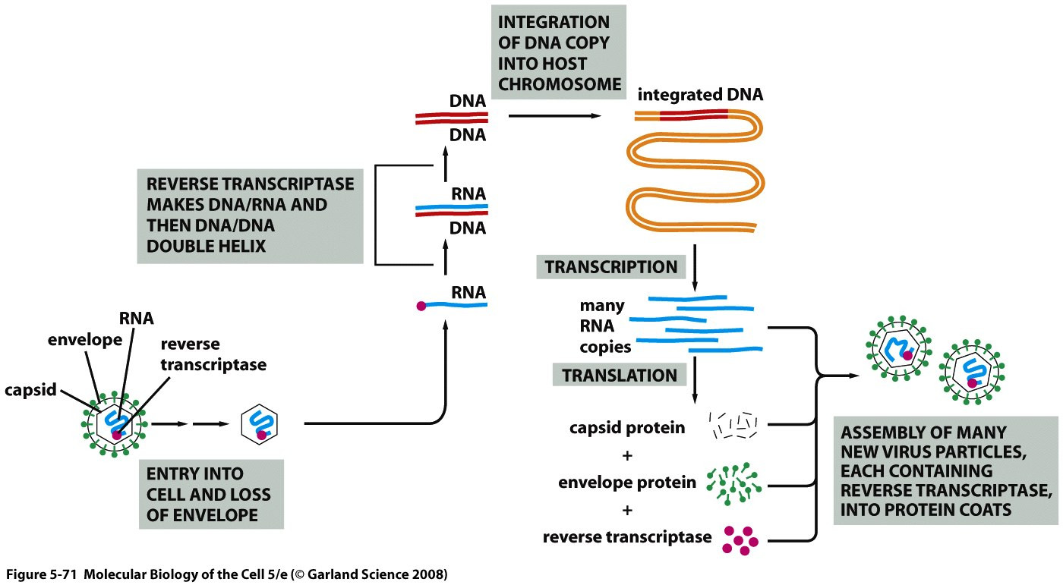
Some virus use a transposition mechanism to move themselves into host cell chromosomes

Slide 51
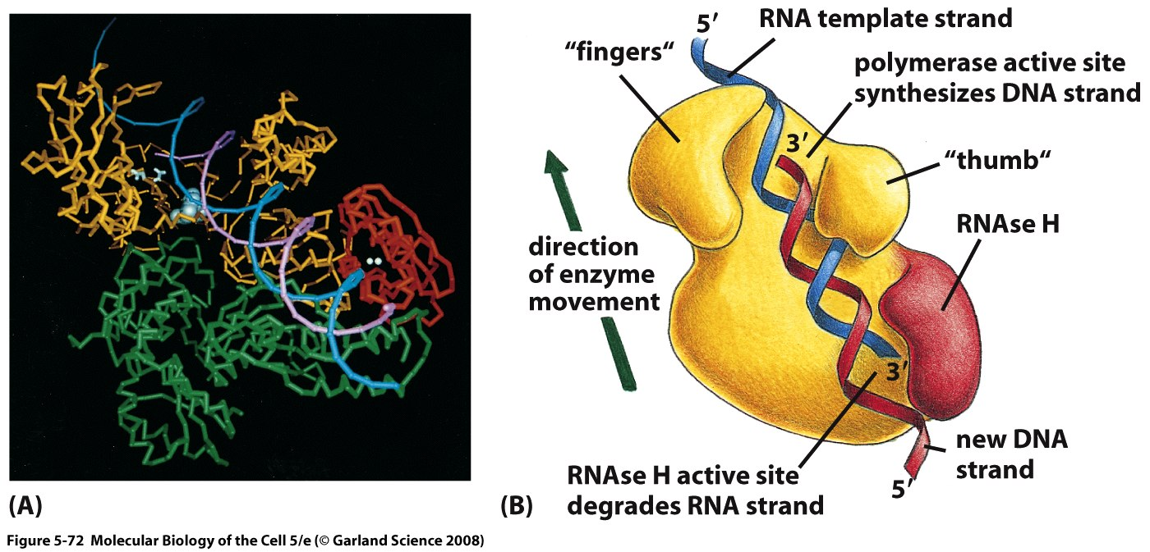
Reverse transcriptase

Slide 52
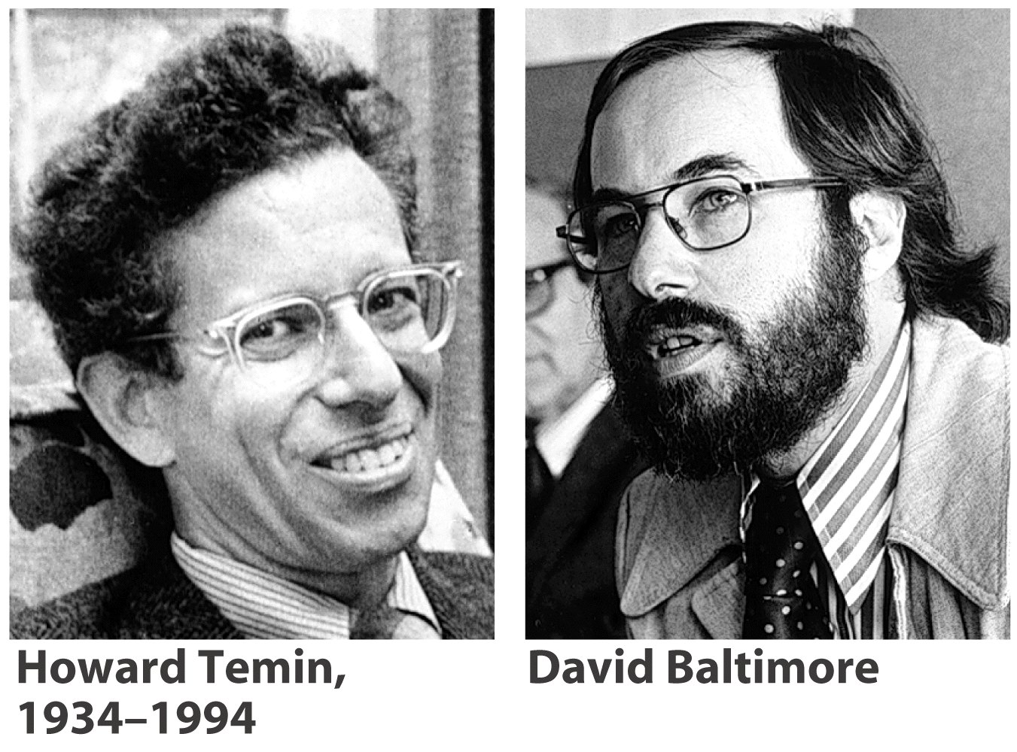

Slide 53
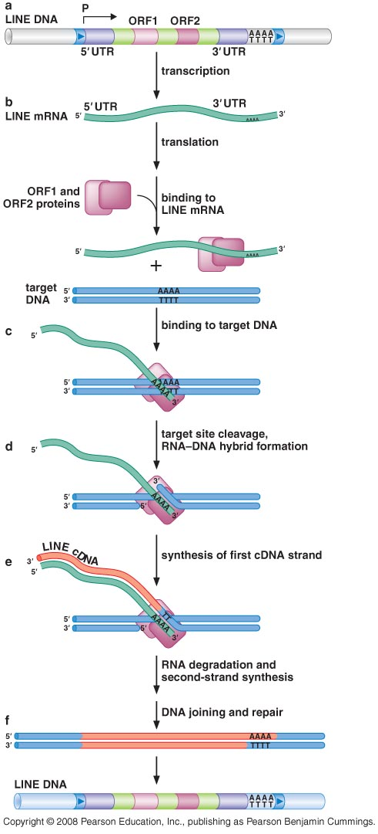
Poly-A retrotransposon

Slide 55
The Nobel Prize in Physiology or Medicine 1983
"for her discovery of mobile genetic elements"
Barbara McClintock
USA
Cold Spring Harbor Laboratory Cold Spring Harbor, NY, USA
b. 1902 d. 1992

